Slide 1
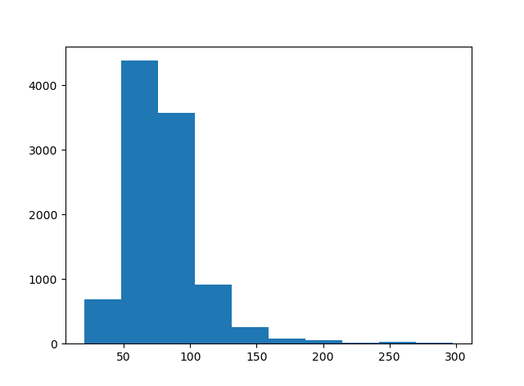
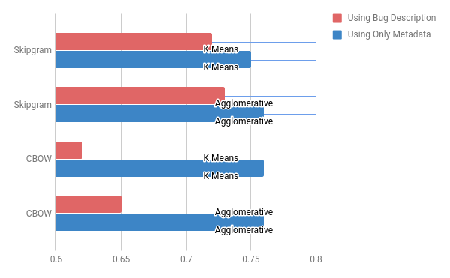
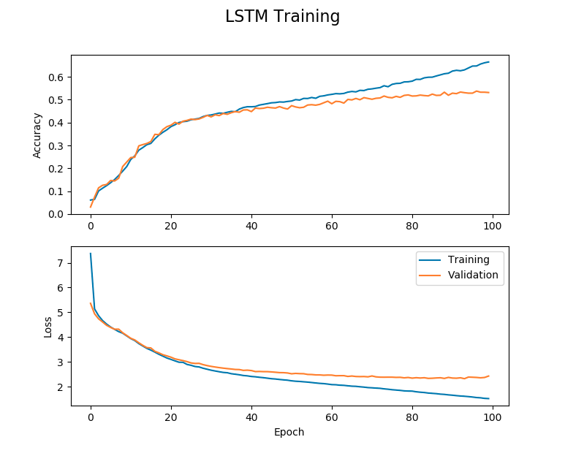
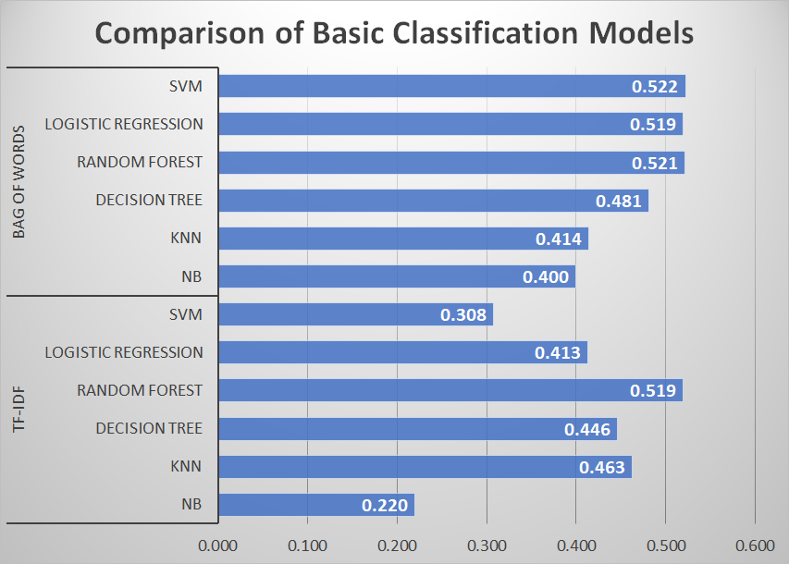
MACHINE LEARNING BASED TICKET CLASSIFICATION - PRATT & WHITNEY
Team: Aishwarya Sudhakar, Ariel Reches, Chris Watson, Kruti Chauhan | Mentors: Abe Handler, Nicholas Monath | Prof Andrew Mccallum
ABSTRACT
The goal of the project is to build a machine learning based ticket classification model. This model would take the incoming tickets in a system and classify them to assignees. The model uses descriptive and categorical domain specific text for learning. Classification can be supervised learning by assigning a ticket to a specific analyst or unsupervised learning where the tickets are put in clusters, the better performing model is to be chosen.
CHARACTER N-GRAM BASED CLASSIFIER
Used FastText - Facebook’s Hierarchical Classifier.
Unbalanced classes
E.g:Getcontentdimensions | Browserelementchildpreload
Sub-word embeddings / character n-grams
Obtain better accuracy with categorical data
Metadata
Free Text
Tickets
Labels
52% - 59% Precision
47% - 49% Precision
DATASET Mozilla Bug Dataset ( 9937 Open Bugs ) Cateogrical, Free Text and Unique Id Columns
CLUSTERING
Cluster input data making each analyst their own cluster
Obtained 75% homogenous clusters
Free Text Column - Length - Histogram
BASELINE MODELS
We used basic sklearn vectorizers and classifiers and got baseline results. Performance was good with SVM and Bag Of Words.
DEEP LEARNING
54% Accuracy achieved by LSTM model
BAD FREE TEXT REPRESENTATION
On querying the word vectors from the basic vectorizers, the free text representation of bugs were bad. Using only metadata from categorical columns seem to provide more meaningful vector representations.
Query: security
Free Text Actual: javascriptvalidatelogin (1 bug), presenting (1 bug), awarded (1 bug)
Free Text Expected: process, sandboxing, enterprise, information
Metadata Actual: process, sandboxing, enterprise, information, caps, risk
Metadata Expected: process, sandboxing, enterprise, information
Reason: Enterprise Process Sandboxing (35 bugs), Enterprise: Information Security(20 bugs)
DELIVERABLE
Pratt and Whitney obtained 80% accuracy on their dataset using the models we built vs 60% on our public dataset!
WHAT DID NOT WORK
No more than 60% accuracy on mozilla dataset
Topic Modelling using LDA
Clusters as a feature for classification
FUTURE WORK
Clustering multiple analysts into a single cluster
Using FastText as vectorizer for our supervised models
Deep Learning
Matrix Factorization

